Slide 1
Production Systems-Matching And Indexing

Slide 2
Production Systems
Production System Consists of
A set of rules :
(Pattern) ➔Operation to be performed
One / more Knowledge/ databases
Control strategy –specifies order in which
rules will be compared
Rule applier

Slide 3
Elements of Production Systems
Representation :
State Space.
Goal States.
Initial States.
Transformation Rules.
Control/ Search Algorithms :
Uninformed.
“Heuristic”.

Slide 4
Control Strategies
How to decide which rule to apply next during searching a solution
Examples
Breadth first search - Hill Climbing
Depth first search - Best First search
Back Tracking

Slide 5
Production System characteristics
Monotonic : application of rule never prevents later application of another rule (that could have been applied at the time first rule was selected)
Non Monotonic : this is not true
Partially commutative : If the application of a particular sequence of rules transform x➔y, then any permutation of those rules ie allowable also transform x➔y
Commutative : both Monotonic & Partially commutative

Slide 6
Indexing
When knowledgebase is too large to be held in main memory, it must be stored as a file in secondary storage.
Storage and retrieval of information in secondary memory is then performed through the transfer of equal size physical blocks.
Time required to transfer a block is same as the time required to sequentially search the whole block.
Grouping together rules which share some of the same conditions and conclusions reduce block transfer times.

Slide 7
Indexing
An indexed organization scheme can reduce the time to determine the storage location of an item.
Indexing is accomplished by organizing the information in some way for easy access.
To build an indexed file, knowledge’s stored as units (such as records) are first arranged sequentially by some key value.
The key can be any chosen field or fields that uniquely identify the record
The key value is the key of the first record stored in the corresponding block. To retrieve an item of knowledge from the main file, the index files searched to find the desired record key and obtain the corresponding block address.

Slide 8
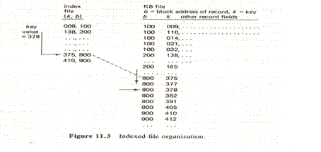
Indexing

Slide 9
Hashed Files: Indexing
Indexed Organizations that permit efficient accesses are based on the use of a hash function.
A hash function, h, transforms key values k into integer storage location indices through a simple computation.
When a maximum number of items or categories C are to be stored, the hashed values h(k) will range from 0 to C-1.
Therefore ,given any key value k,h(k)should map into one of 0…C-1
This type of organization is well suited for groups of items corresponding to C different categories.
When two or more items belong to the same category, they will have the same hashed values. These values are called synonyms.

Slide 10
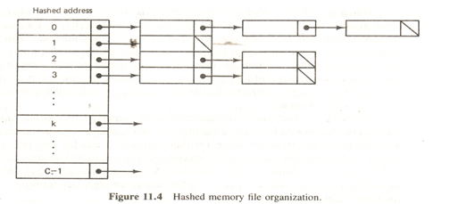
Hashed Files: Indexing

Slide 11
Conceptual Hashing:Indexing
Keys for conceptual hashing are typically chosen as a coded field (employee number, name, part number, and so on) which uniquely identifies the item.
A better approach to indexed retrieval is one which makes use of the content or meaning associated with the stored entities rather than some no meaningful key value.
Nodes within the network correspond to different knowledge entities.
Links connecting two entities name the association or relationship between them.
Objects may be classified with an unlimited number of attributes (color, size, shape, markings, and so on).
A good index for bird types is one based on individual differences like feet, size, beak shape, sound emitted, special markings, and so forth.

Slide 12
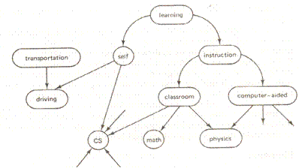
Conceptual Hashing:Indexing

Slide 13
Matching
Intelligent Searching involves choosing from among the rules that can be applied at a particular point, the ones that are most likely to lead to a solution.
It requires some kind of matching between current state and the preconditions of the rules.
Matching between a particular situation and the preconditions of a given rules itself involve a significant search process.
Backward chaining systems usually use depth first backtracking to select individual rules, but forward chaining systems employ conflict resolution strategies to choose among the applicable rules.

Slide 14
Complex And Approximate matching
Complex matching is required when the preconditions of a rule specify required properties are not stated explicitly in the description of the current state. In this case ,a separate set of rules must be used to describe how some properties can be inferred from others.
An even more complex matching process is required if rules should be applied if their preconditions approximately match the current situation.
For example, Speech-understanding program must contain rules that map from a description of a physical waveform to phones(instances of English phonemes, such as p or d)

Slide 15
Conflict Resolution
The result of match process is a list of rules whose antecedents have matched the current state description along with whatever variable bindings were generated by the matching process.
There are 3 basic Approaches to resolve the conflict.
1.Preferences based on Rules
Matcher rejects rules that are more general than other rules that also match.
2.Preferences Based on Objects
Matches find based on the importance of the object
3.Preferences Based on States
If All rules matched fire all and wait for responses

Slide 16
Summary
Production System Characteristics
(Monotonic,NonMonotonic,Commutative,Partially Commutative)
Indexing
(Hashed Files Indexing, Conceptual Indexing)
Matching
(Complex Matching, Approximate Matching)
Conflict resolution
(Based on rules, Based on objects, Based on states)

